Slide 1
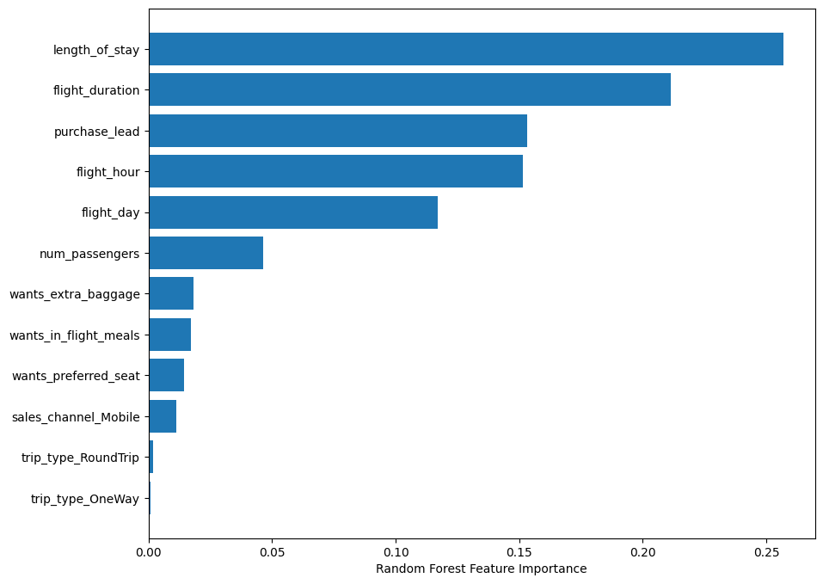
Predictive ML model Results ML-model: Random Forest Classification
Accuracy: 90%
It represents the prediction of correctly identifying successful and unsuccessful booking from ML model.
Precision: 95%
It represents the prediction of actual successful booking(correctly) from all predicted successful booking instances.
Recall: 87%
It represents the prediction of actual successful booking (correctly) from all actual booking instances.
F1-Score: 91%
It represents Harmonic mean of Precision and Recall and gives a balance score between the two.
ROC-AUC Score: 90%
The Area Under the ROC Curve (ROC-AUC) provides an aggregate measure of performance across all possible classification thresholds.
Top Features affecting booking completion

